Slide 1

Customer analysis
Bike sales

Slide 2
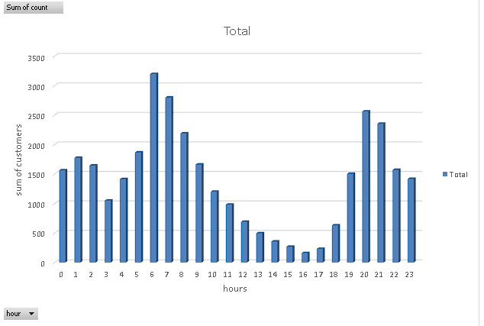
Hourly customer demand
• Customer activity peaks in early morning (6-8 AM)
• Lowest demand is observed in afternoon hours (2-5 PM)
• Another rise appears during late evening (8-10 PM)
• This indicates strong commuting and evening usage patterns.

Slide 3
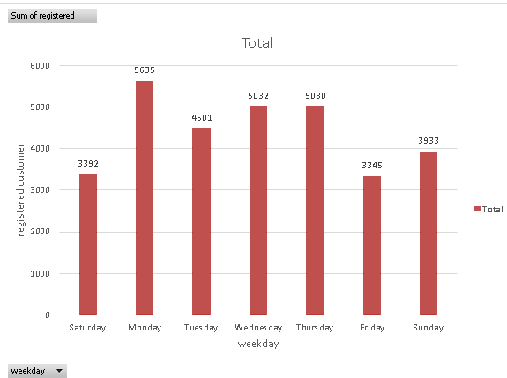
Wwekday wise registered users
• Monday records the highest registered users.
. Wednesday and Thursday also show strong engagement
• Friday has the lowest registration activity. . Weekdays outperform weekends overall

Slide 4
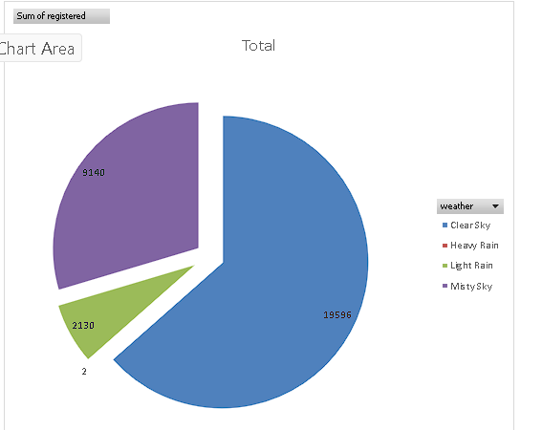
Impact of weather
• Clear sky dominates customer usage. • Mist/cloudy weather contributes moderately.
• Light rain has limited impact. • Heavy rain almost completely reduces usage.

Slide 5
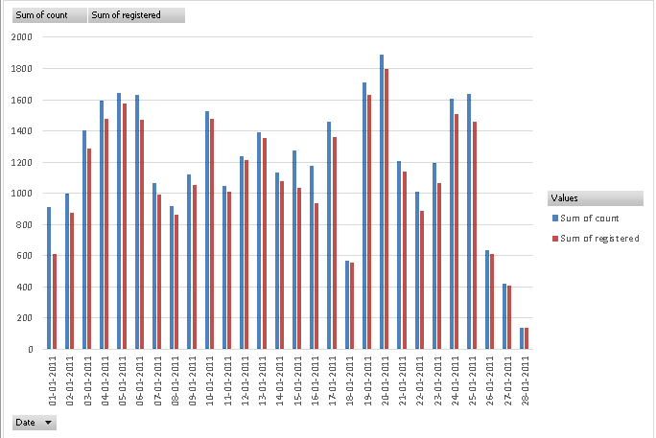
Daily count vs registered users
• Daily trends of casual and registered users move together.
. Peak activity seen around mid-month . Sharp drop towards month-end • Registered users consistently contribute major share.

